Slide 1
Customer Ratings
Capstone Project
By: Lucas Noto

Slide 2
The Business
Customer Ratings specializes in increasing overall rating for grocery stores
Searching downtown for clients
Has 3 Packages available:
Basic
Intermediate
Expert

Slide 3
The Tool
This tool will search nearby venues and their ratings
Then attaches each venue to a package
Match the customer with the package sales pitch
Having a higher rating can attract new customers

Slide 4

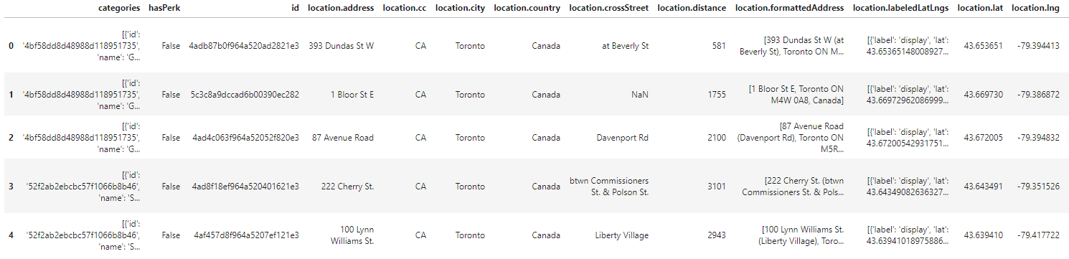
Data
FourSquare
Category: Grocery Store, searched within a 5 kilometer radius
JSON Database of venues

Slide 5
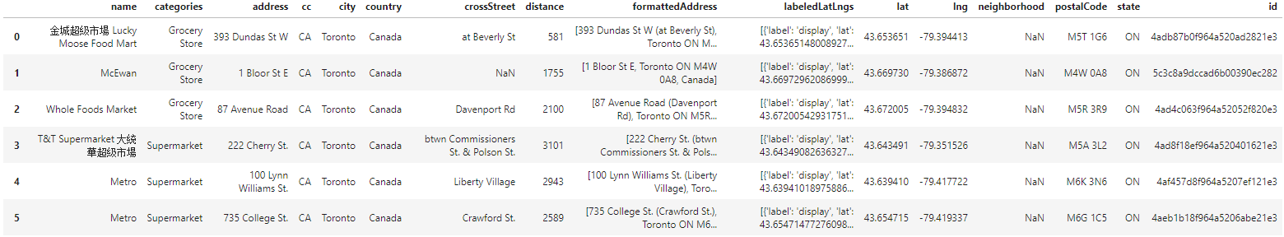
Data
The JSON was then converted into a readable database

Slide 6
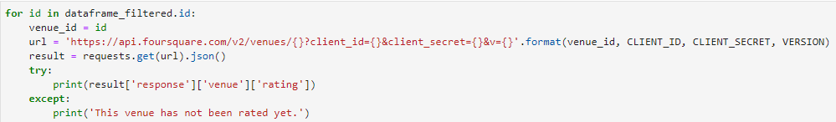
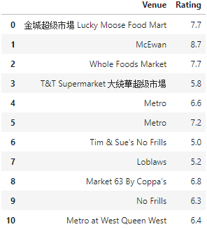
Data
Using the venue ID, the ratings were compiled
The ratings were out of 10

Slide 7

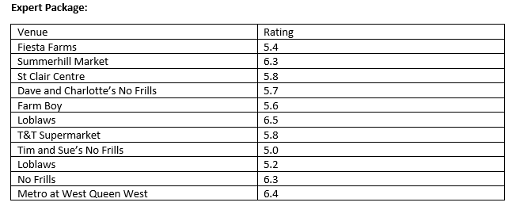
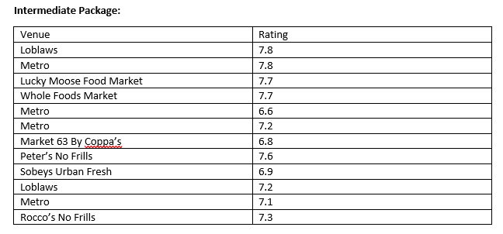
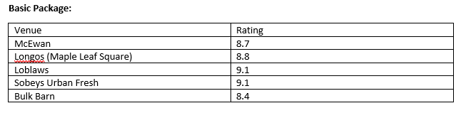
Results
Results of what package that should be offered to each venue

Slide 8
Conclusion and Future Directions
More companies need a better package than basic
Venues nearing U of T Campus had lower ratings
Ideas include:
Surveys of surrounding residents can give more data as to why ratings are lower closer to U of T Campus
Survey workers of locations to see working conditions

